Slide 1
Lecture 3: Linear Regression A
Instructor: Yang Xu
Slides adopted from Xiaobai Liu

Slide 2
Outline
Task Formulation
Cost Function
Method 1: Normal Equation
Method 2: Gradient Descent

Slide 3
Mental model
Tasks:
Predict spam/not, housing price etc.
Data
Data
Data
Learning/training
Data
Data
Data
Model Parameters:
$θ_{1}$, $θ_{2}$, $θ_{3}$…
New data
Data
Data
Data
Data
Data
Data
Data
Data
Data

Slide 4
Regression: single feature (simple linear regression)
Predict housing price
Price (K$)
300
200
100
500
1000
1500
2000
2500
3000
Size (feet²)
Supervised Learning
Feature: size
Label: price (real number)

Slide 5

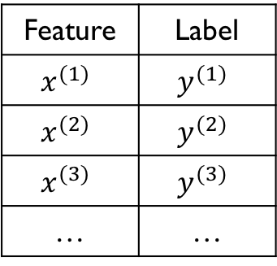

Training Set (92115)
Size (feet²) | Price (k$)
856 | 399.5
1512 | 449
865 | 350
1044 | 345
… | …
Notation
Feature | Label
$$x^{(1)}$$ | $$y^{(1)}$$
$$x^{(2)}$$ | $$y^{(2)}$$
$$x^{(3)}$$ | $$y^{(3)}$$
… | …
Single parameter: $θ_{1}$
Simple idea: use $θ_{1}x$ to predict
Intercept parameter: $θ_{0}$, why?

Slide 6
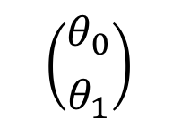
Mental model
Tasks:
Predict spam/not, housing price etc.
Data
Data
Data
Learning/training
Data
Data
Data
$$\left({θ_{0} \atop θ_{1}}\right)$$
New data
Data
Data
Data
Data
Data
Data
Simple linear model
Data
Data
Data

Slide 7
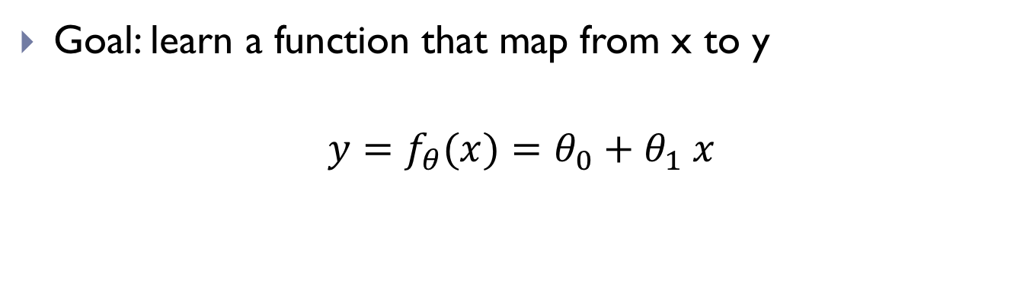
Linear Regression
Goal: learn a function that map from x to y
$$y=f_{θ}(x)=θ_{0}+θ_{1} x$$
y
x
($θ_{0}$, $θ_{1}$): parameters to learn (intercept and slope)

Slide 8
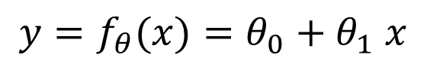
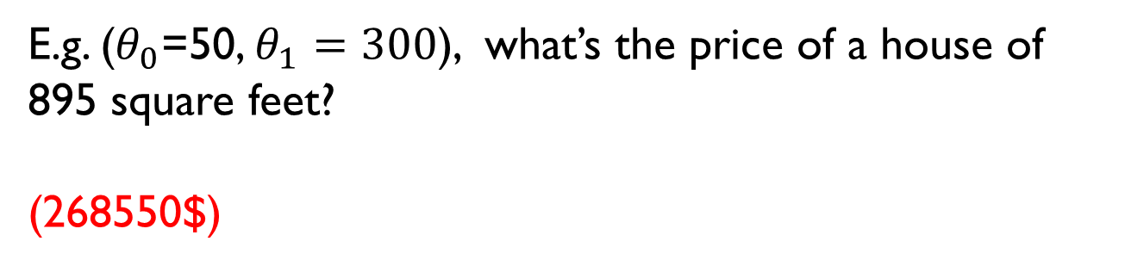
Quiz
$$y=f_{θ}(x)=θ_{0}+θ_{1} x$$
E.g. ($θ_{0}$=50, $θ_{1}=300$), what’s the price of a house of 895 square feet?
(268550$)

Slide 9
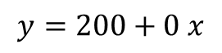
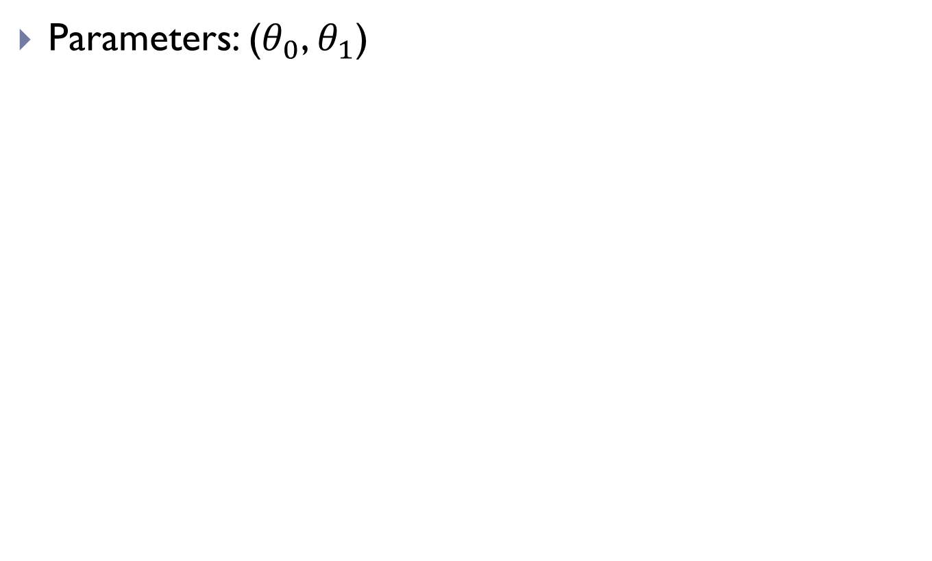
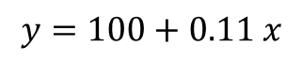
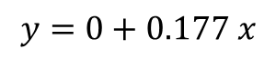
Showcase different parameter values
Parameters: ($θ_{0}$, $θ_{1}$)
$$y=0+0.177 x$$
Price (K$)
300
$$y=100+0.11 x$$
$$y=200+0 x$$
200
100
500
1000
1500
2000
2500
3000

Slide 10
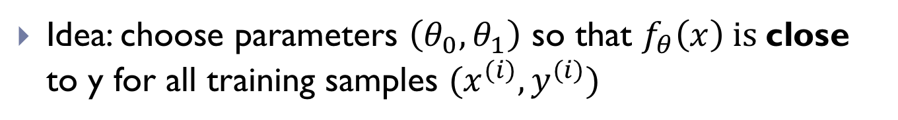

How to find the best $\left(θ_{0}, θ_{1}\right)$?
Which one is the best?
Price (K$)
300
200
100
500
1000
1500
2000
2500
3000
Size (feet²)
Idea: choose parameters $\left(θ_{0}, θ_{1}\right)$ so that $f_{θ}\left(x\right) is$close to y for all training samples $(x^{(i)},y^{(i)})$

Slide 11
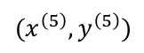
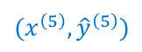

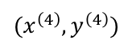
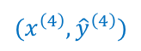
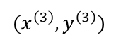
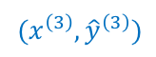
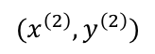
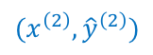
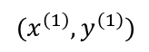
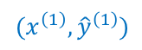
What do we mean by “close”?
Predicted value ${\hat{y}}^{(i)}=f_{θ}\left(x^{\left(i\right)}\right)=θ_{0}+θ_{1}x^{(i)}$
$$(x^{\left(5\right)},y^{\left(5\right)})$$
Price (K$)
300
$$(x^{\left(3\right)},y^{\left(3\right)})$$
$$(x^{\left(4\right)},{\hat{y}}^{\left(4\right)})$$
$$(x^{\left(5\right)},{\hat{y}}^{\left(5\right)})$$
$$(x^{\left(1\right)},y^{\left(1\right)})$$
Objective: minimize the distances
200
$$(x^{\left(2\right)},{\hat{y}}^{\left(2\right)})$$
$$(x^{\left(3\right)},{\hat{y}}^{\left(3\right)})$$
$$(x^{\left(4\right)},y^{\left(4\right)})$$
100
$$(x^{\left(2\right)},y^{\left(2\right)})$$
$$(x^{\left(1\right)},{\hat{y}}^{\left(1\right)})$$
500
1000
1500
2000
2500
3000

Slide 12
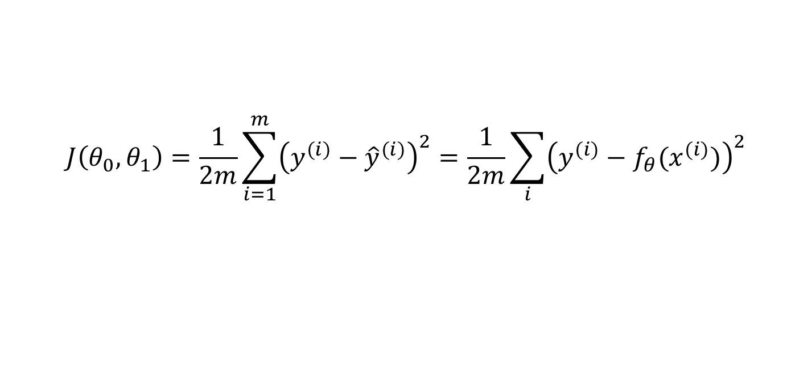
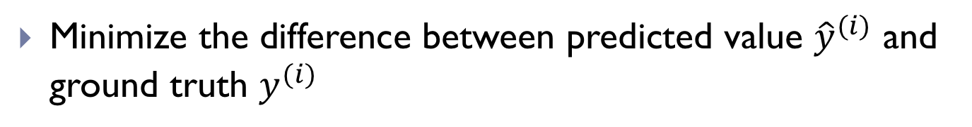
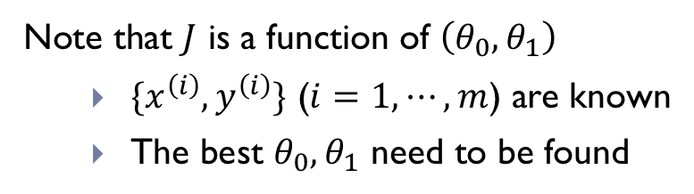
Learning objective
Minimize the difference between predicted value ${\hat{y}}^{(i)}$ and ground truth $y^{(i)}$
Minimize ${(y^{(1)}−{\hat{y}}^{(1)})}^{2}+{(y^{(2)}−{\hat{y}}^{(2)})}^{2}+⋯{(y^{(5)}−{\hat{y}}^{(5)})}^{2}$
Cost function: Mean Square Error (MSE)
$$J\left(θ_{0},θ_{1}\right)=\frac{1}{2m}\sum_{i=1}^{m}{{\left(y^{(i)}−{\hat{y}}^{(i)}\right)}^{2}}=\frac{1}{2m}\sum_{i}{{\left(y^{(i)}−f_{θ}(x^{(i)})\right)}^{2}}$$
Note that $J$ is a function of $\left(θ_{0},θ_{1}\right)$
$\{x^{\left(i\right)},y^{\left(i\right)}\}$ ($i=1,⋯,m$) are known
The best $θ_{0},θ_{1}$ need to be found

Slide 13
Outline
Task Formulation
Cost Function
Method 1: Normal Equation
Method 2: Gradient Descent

Slide 14
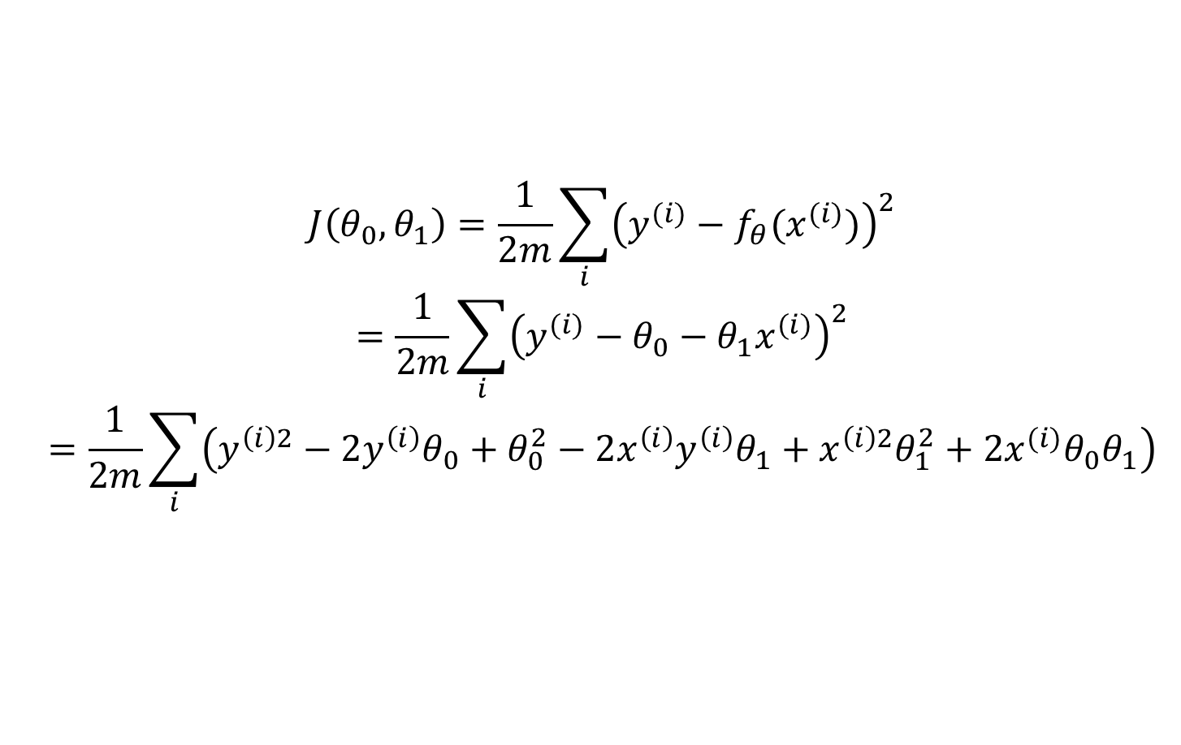
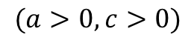
How to solve the minimization problem?
Expand cost function
$$J\left(θ_{0},θ_{1}\right)=\frac{1}{2m}\sum_{i}{{\left(y^{(i)}−f_{θ}(x^{(i)})\right)}^{2}}$$
$$=\frac{1}{2m}\sum_{i}{{\left(y^{(i)}−θ_{0}−θ_{1}x^{(i)}\right)}^{2}}$$
$$=\frac{1}{2m}\sum_{i}{\left(y^{\left(i\right)2}−2y^{\left(i\right)}θ_{0}+θ_{0}^{2}−2x^{\left(i\right)}y^{\left(i\right)}θ_{1}+x^{\left(i\right)2}θ_{1}^{2}+2x^{(i)}θ_{0}θ_{1}\right)}$$
$J\left(θ_{0},θ_{1}\right)=aθ_{0}^{2}+bθ_{0}+cθ_{1}^{2}+dθ_{1}+e$ $θ_{0}θ_{1}+d$
$$(a>0,c>0)$$

Slide 15
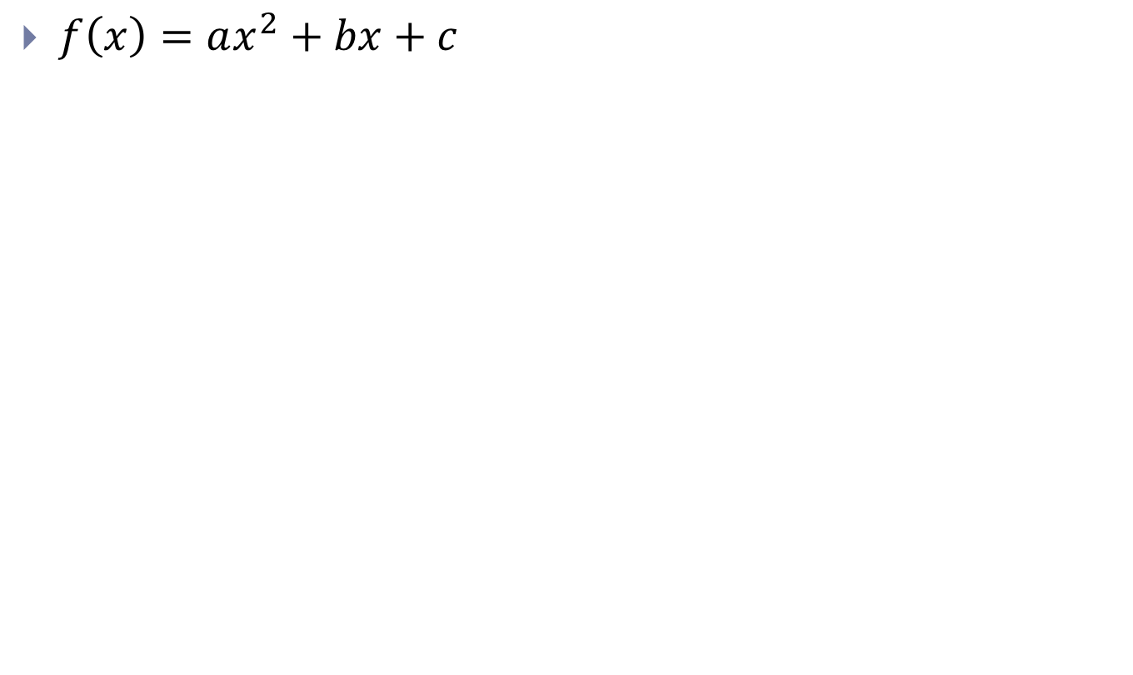
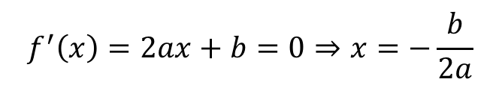
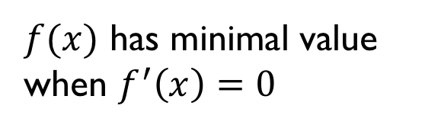
Shape of a quadratic function
$f\left(x\right)=ax^{2}+bx+c$
$f(x)$ has minimal value when $f^{′}\left(x\right)=0$
$$f^{′}\left(x\right)=2ax+b=0⇒x=−\frac{b}{2a}$$

Slide 16
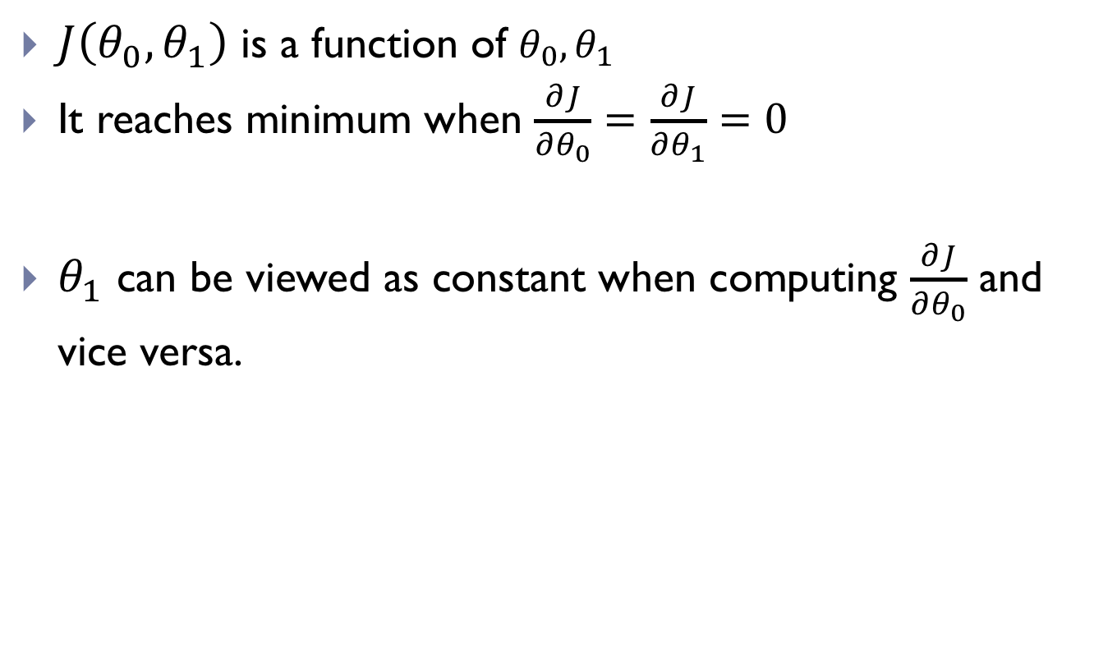
Derivatives of cost function
$J\left(θ_{0},θ_{1}\right)$ is a function of $θ_{0},θ_{1}$
It reaches minimum when $\frac{∂J}{∂θ_{0}}=\frac{∂J}{∂θ_{1}}=0$
$θ_{1}$ can be viewed as constant when computing $\frac{∂J}{∂θ_{0}}$ and vice versa.

Slide 17
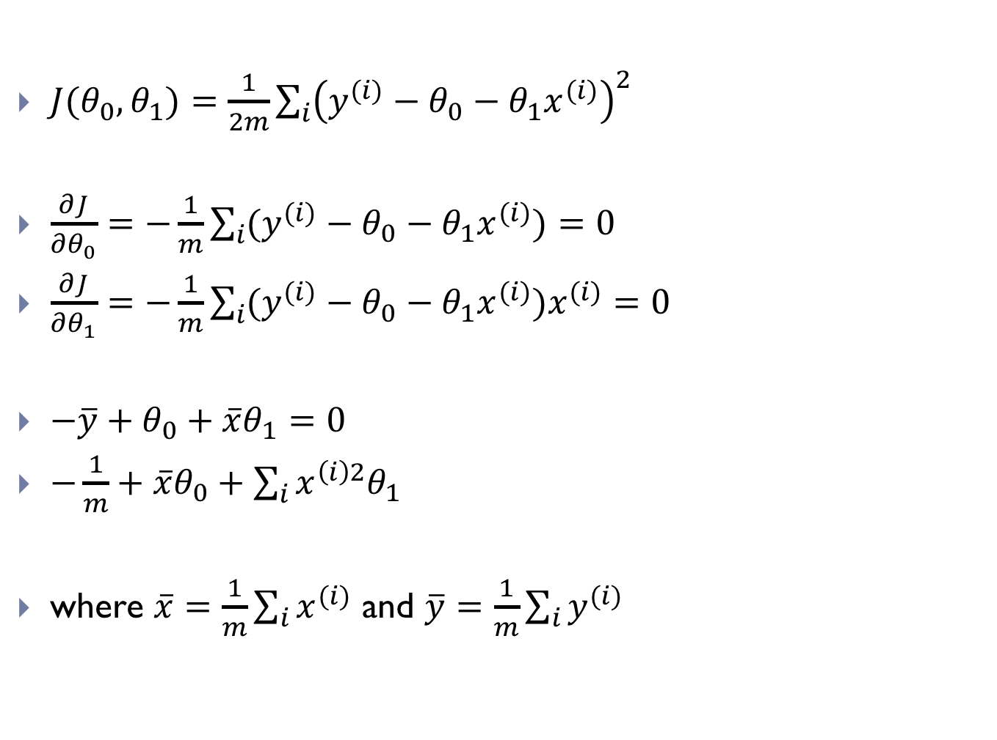
Derivatives of cost function (cont.)
$J(θ_{0},θ_{1})=\frac{1}{2m}\sum_{i}{{\left(y^{(i)}−θ_{0}−θ_{1}x^{(i)}\right)}^{2}}$
$\frac{∂J}{∂θ_{0}}=−\frac{1}{m}\sum_{i}{(y^{(i)}−θ_{0}−θ_{1}x^{(i)})}=0$
$\frac{∂J}{∂θ_{1}}=−\frac{1}{m}\sum_{i}{(y^{(i)}−θ_{0}−θ_{1}x^{(i)})x^{(i)}}=0$
${−\overline{y}+θ}_{0}+\overline{x}θ_{1}=0$
$−\frac{1}{m}+\overline{x}θ_{0}+\sum_{i}{x^{\left(i\right)2}θ_{1}}$
where $\overline{x}=\frac{1}{m}\sum_{i}{x^{(i)}}$ and $\overline{y}=\frac{1}{m}\sum_{i}{y^{(i)}}$
Can be solved

Slide 18
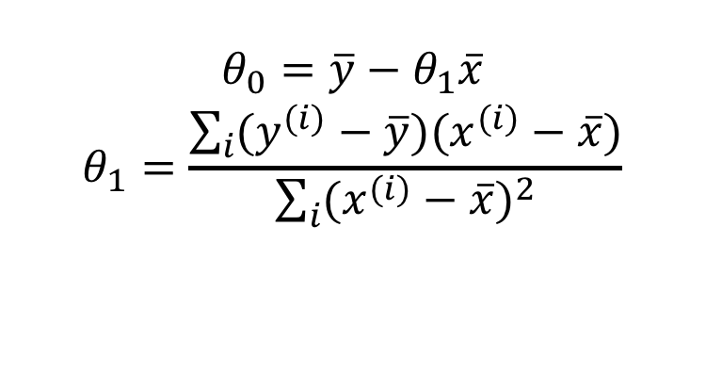
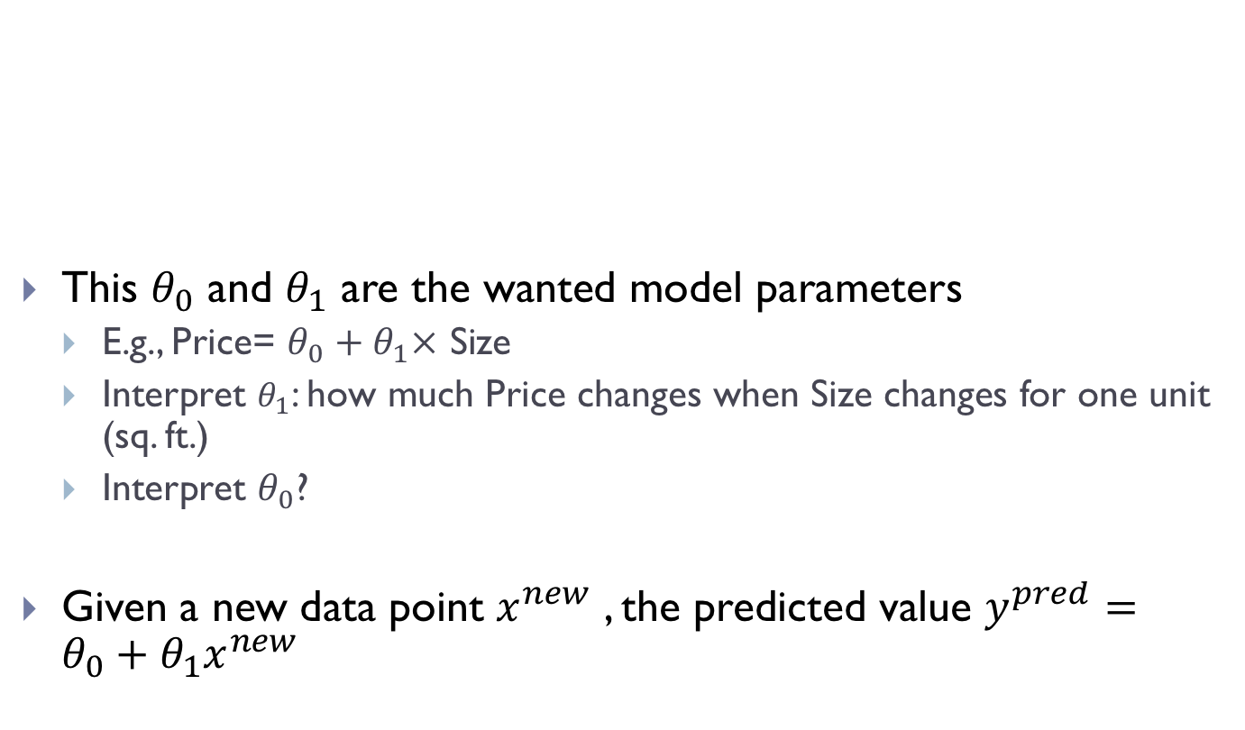
Normal equation solutions
This $θ_{0}$ and $θ_{1}$ are the wanted model parameters
E.g., Price= ${θ_{0}+θ}_{1}×$ Size
Interpret $θ_{1}$: how much Price changes when Size changes for one unit (sq. ft.)
Interpret $θ_{0}$?
Given a new data point $x^{new}$ , the predicted value $y^{pred}=θ_{0}+θ_{1}x^{new}$
$$θ_{0}=\overline{y}−θ_{1}\overline{x}$$
$$θ_{1}=\frac{\sum_{i}{(y^{(i)}−\overline{y})(x^{(i)}−\overline{x})}}{\sum_{i}{{(x^{(i)}−\overline{x})}^{2}}}$$

Slide 19


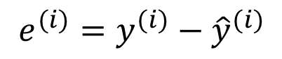



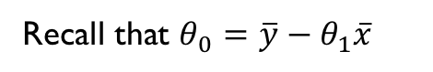



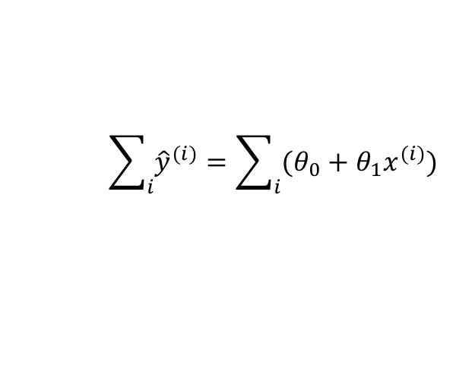



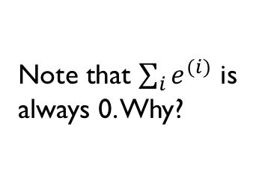
Evaluation
How good is the model?
The differences between $y^{(i)}$ and ${\hat{y}}^{(i)}$
$$e^{(i)}=y^{(i)}−{\hat{y}}^{(i)}$$
$$y^{\left(5\right)}$$
Note that $\sum_{i}{e^{(i)}}$ is always 0. Why?
Price (K$)
300
$$y^{\left(3\right)}$$
$${\hat{y}}^{\left(4\right)}$$
$$y^{\left(1\right)}$$
$${\hat{y}}^{\left(5\right)}$$
$$\sum_{i}{{\hat{y}}^{(i)}}=\sum_{i}{(θ_{0}+θ_{1}x^{(i)})}$$
200
$${\hat{y}}^{\left(2\right)}$$
$${\hat{y}}^{\left(3\right)}$$
$$y^{\left(4\right)}$$
100
$$y^{\left(2\right)}$$
Recall that $θ_{0}=\overline{y}−θ_{1}\overline{x}$
$${\hat{y}}^{\left(1\right)}$$
500
1000
1500
2000
2500
3000

Slide 20
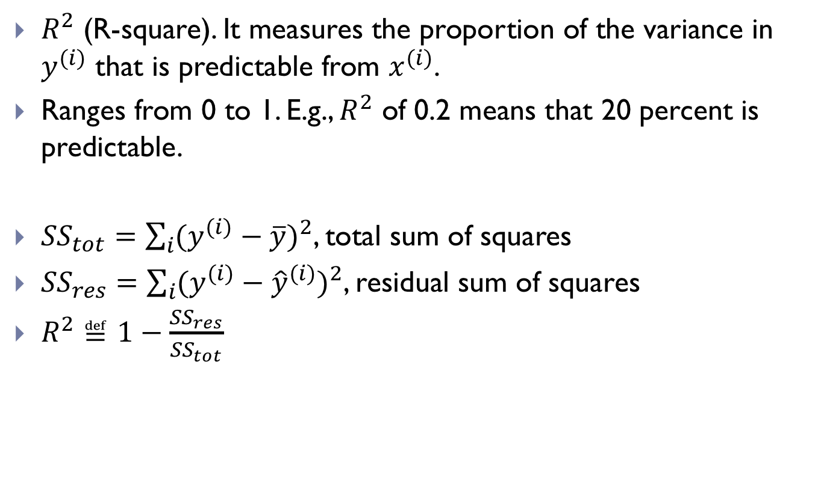
Coefficient of determination
$R^{2}$ (R-square). It measures the proportion of the variance in $y^{(i)}$ that is predictable from $x^{(i)}$.
Ranges from 0 to 1. E.g., $R^{2}$ of 0.2 means that 20 percent is predictable.
${SS}_{tot}=\sum_{i}{{(y^{(i)}−\overline{y})}^{2}}$, total sum of squares
${SS}_{res}=\sum_{i}{{(y^{(i)}−{\hat{y}}^{(i)})}^{2}}$, residual sum of squares
$R^{2}≝1−\frac{{SS}_{res}}{{SS}_{tot}}$

Slide 21
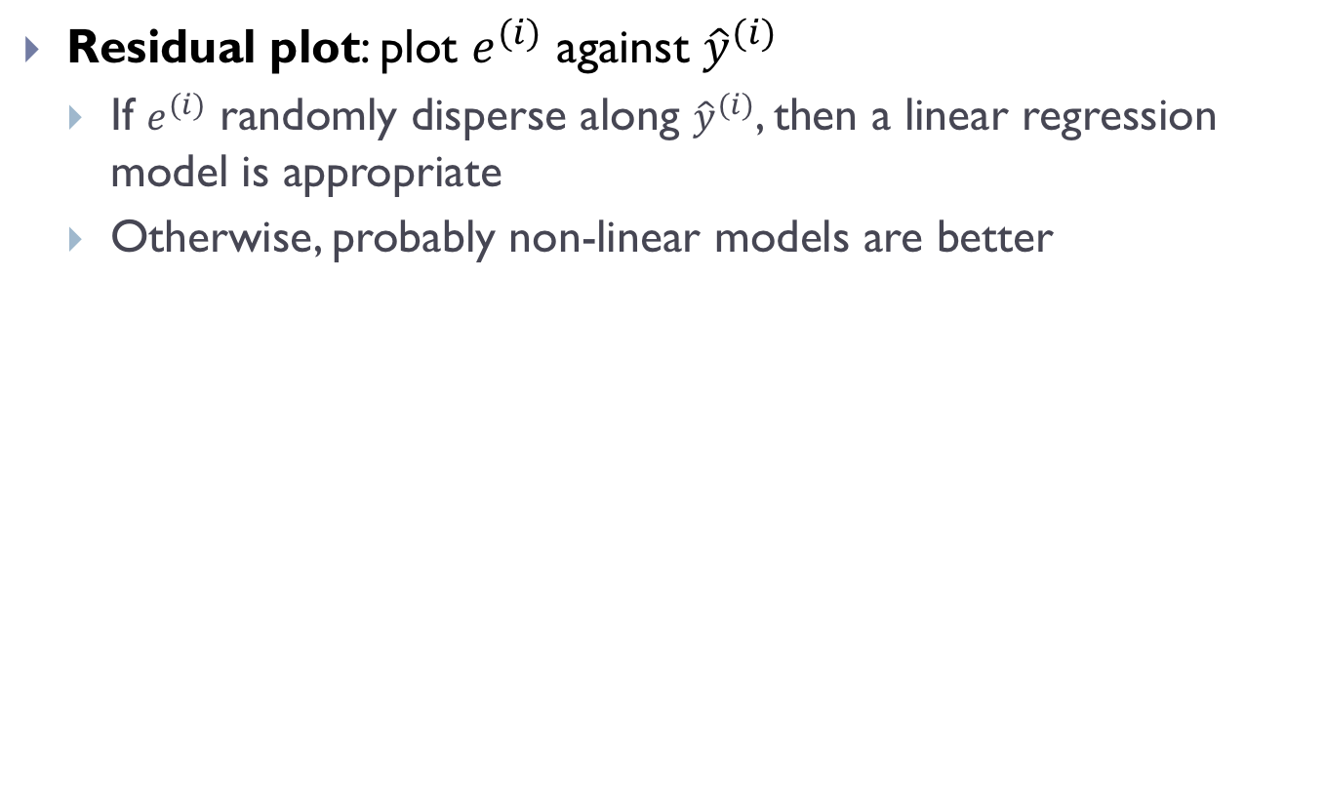
Residual plot
Residual plot: plot $e^{(i)}$ against ${\hat{y}}^{(i)}$
If $e^{(i)}$ randomly disperse along ${\hat{y}}^{(i)}$, then a linear regression model is appropriate
Otherwise, probably non-linear models are better

Slide 22
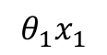
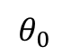
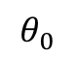
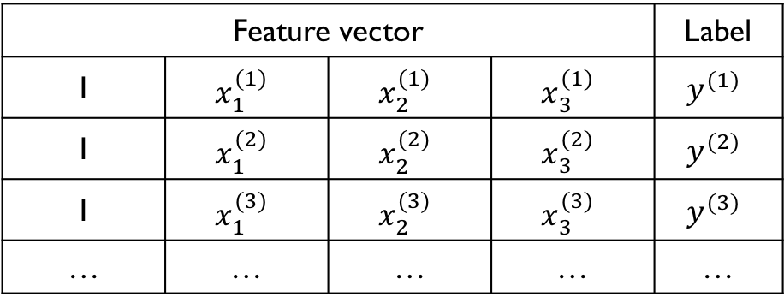
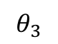
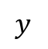
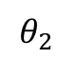
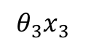
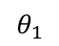
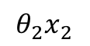
What if more features?
Not only Size can predict Price
Other predictors: Year, Location, Bedroom#, …
Feature vector |  |  |  | Label
1 | $$x_{1}^{(1)}$$ | $$x_{2}^{(1)}$$ | $$x_{3}^{(1)}$$ | $$y^{(1)}$$
1 | $$x_{1}^{(2)}$$ | $$x_{2}^{(2)}$$ | $$x_{3}^{(2)}$$ | $$y^{(2)}$$
1 | $$x_{1}^{(3)}$$ | $$x_{2}^{(3)}$$ | $$x_{3}^{(3)}$$ | $$y^{(3)}$$
… | … | … | … | …
Associated
parameters
$$θ_{0}$$
$$θ_{1}$$
$$θ_{2}$$
$$θ_{3}$$
$$θ_{0}$$
+
$$θ_{1}x_{1}$$
+
$$θ_{2}x_{2}$$
+
$$θ_{3}x_{3}$$
→
$$y$$

Slide 23
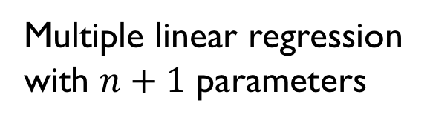
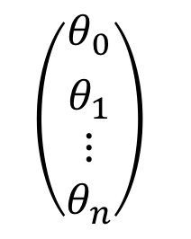
Extended to multiple features
Tasks:
Predict spam/not, housing price etc.
Data
Data
Data
Learning/training
Data
Data
Data
$$\left(\begin{aligned}{θ_{0} \atop θ_{1}} \\ ⋮ \\ θ_{n}\end{aligned}\right)$$
New data
Data
Data
Data
Data
Data
Data
Data
Data
Data
Multiple linear regression
with $n+1$ parameters

Slide 24




Multiple linear regression
Goal: Learn a function that maps $\vec{x}$ to $y$.
Predicted value
Cost function
$$y=f_{θ}\left(\vec{x}\right)=θ_{0}+θ_{1}x_{1}+⋯+θ_{n}x_{n}$$
$${\hat{y}}^{(i)}=f_{θ}\left(x^{\left(i\right)}\right)=θ_{0}+θ_{1}x_{1}^{(i)}+⋯+θ_{n}x_{n}^{(i)}$$
$$J\left(θ_{0},θ_{1},⋯θ_{n}\right)=\frac{1}{2m}\sum_{i}{{\left(y^{(i)}−θ_{0}−θ_{1}x_{1}^{\left(i\right)}−⋯−θ_{n}x_{n}^{(i)}\right)}^{2}}$$

Slide 25

Matrix representations
Data $X_{m×(n+1)}$, $y_{m×1}$
Model parameters $θ_{1×(n+1)}$

Slide 26

Matrix representations (cont.)
Predicted value $\hat{y}=Xθ$

Slide 27

Matrix representations (cont.)
Cost function $J\left(θ\right)={\frac{1}{2m}\left(y−\hat{y}\right)}^{T}(y−\hat{y})$
Same term

Slide 28

Compute derivative
Compute the derivative of $J\left(θ\right)$ w.r.t. $θ$
More details, see: https://eli.thegreenplace.net/2015/the-normal-equation-and-matrix-calculus/
Analogy to scalar
Solution found!

Slide 29







Tips
When computing the derivative of cost function $J$ w.r.t. a vector of parameters:
$\frac{∂J}{∂θ}$ is of the same dimension of $θ$
Check dimensions
$\dim\left(θ\right)=(n+1)×1,\dim\left(y\right)=m×1,\dim\left(X\right)=m×(n+1)$
Cost $J\left(θ\right)$ is a scalar, i.e., $dim\left(J\left(θ\right)\right)=1×1$
$$θ={\left(X^{T}X\right)}^{−1}X^{T}y$$
$$(n+1)×1$$
$$(n+1)×m$$
$$m×(n+1)$$
$$(n+1)×m$$
$$m×1$$

Slide 30

Mental model
Tasks:
Predict spam/not, housing price etc.
Data
Data
Data
Learning/training
Data
Data
Data
$$\left(\begin{aligned}{θ_{0} \atop θ_{1}} \\ ⋮ \\ θ_{n}\end{aligned}\right)$$
New data
Data
Data
Data
Data
Data
Data
Data
Data
Data
$X$ and $y$

Slide 31

Issues with normal equation method
Very fast to compute in case of one feature (single linear regression)
However, very slow to compute the inverse of a matrix when $n$ is large

Slide 32
Outline
Task Formulation
Cost Function
Method 1: Normal Equation
Method 2: Gradient Descent

